Slide 1
Medical mycology
Dr. Najwan Abbas Mohammed
Lecture 1

Slide 2
Introduction to medical mycology
Mycology is a branch of natural science involved in studies related to fungi, their structure, genetic composition, biochemical properties, taxonomy, and their applications.
1. What are Fungi: Fungi are eukaryotic microorganisms that occur as yeasts, molds, or as a combination of both forms. The characteristic features of fungi include the chitinous cell walls, plasma membranes containing ergosterol, 80S rRNA, and microtubules composed of tubulin.
Fungi constitute a very large group of living organisms showing distinctive characteristics.
Being eukaryotes, they differ sharply from prokaryotes (Bacteria, Cyanobacteria or Archaea) by having nuclei and cell organelles. Whoever, they are distinct from other relative groups of eukaryotes (Protista, Plants or Animals).

Slide 3
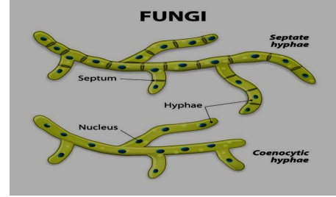
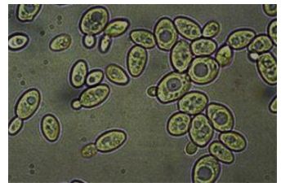
2. Fungal Body: The fungal body of most fungi (the Mycelium)) is composed of Hyphae which are almost uniform branching tubular structures that show apical longitudinal growth
The mycelium is either aseptate (without septa) also called Coenocytic or Septate (with transverse walls)
A smaller but still important group of fungi is the Yeasts, form no true hyphae. Instead yeast body is composed of discrete cells which grow mostly by budding or less frequently by fission, and occasionally form Psuedohyphae

Slide 4
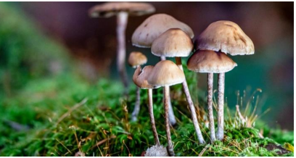
Fungi that exhibit mycelial mode of growth called filamentous fungi or molds. The vast majority of fungi are microscopic organisms that occasionally referred to as Micro Fungi. Some fungi however, form visible or even large fruiting bodies as in the case of mushrooms and truffles which may refer to as Macro Fungi.
In either case fungal cell, the fungal body components, hyphae and their reproductive units are microscopic

Slide 5
3. Fungal Nutrition:
Without exception, all fungi are Heterotrophic organisms being unable to synthesize their
own organic nutrients from inorganic resources. Therefore, they have to utilize organic
compounds already formed by other autotrophic (plants, algae, etc.) or heterotrophic (animals,
human, etc.) organisms. Being heterotrophs, fungi behave as
(a.) Saprophytes using dead organic nutrients,
(b) as parasites gaining nutrients from living organisms in an invasive way (Parasites) or
(c) through mutual symbiosis with algae (Lichens), plant tissues (Endophytes) or plant
roots (Mycorrhiza).
In their mode of nutrition, fungi show Absorptive or Osmophilic life style. They are either
absorbing soluble simple nutrients or digesting complex food particles outside their bodies by
the aid of extracellular enzymes. Hence, generally speaking fungi always live inside nutrient
media.

Slide 6
In their mode of nutrition, fungi show Absorptive or Osmophilic life style. They are either absorbing soluble simple nutrients or digesting complex food particles outside their bodies by the aid of extracellular enzymes. Hence, generally speaking fungi always live inside nutrient media. 4
4. Most Fungi Are Aerobic: With few exceptions such as Chytrids living in rumen of ruminants or in deep oceans as anaerobes, all fungi are aerobic using atmospheric oxygen in respiration. Nevertheless, yeasts are capable of anaerobic respiration or fermentation under anaerobic conditions.

Slide 7
5. Cytology of Fungi:
A. Cell Wall:
All fungal cells including hyphae, yeast cells or spores are enclosed by a rigid cell wall that is composed of polysaccharides and proteins with chitin and glucans as distinctive major constituents. An exception to this rule is represented by Zoospores produced by fungi belonging to Chytridiomycota.
Zoospores are swimming reproductive fungal cells lacking cell wall.

Slide 8
B. Nucleus:
Nuclei of the vast majority of fungi are haploid, i.e. with one set of chromosomes (1 N chromosome number), while the diploid state i.e. with double set of chromosomes (2 N chromosome) is restricted to the zygote (the product of sexual reproduction) that is forming haploid cells through meiosis and some yeasts like Candida albicans. This feature made fungi to be used as excellent models in genetic studies
C. Special Characteristics of Fungi: In addition, fungi show certain peculiarities such as: persistence of the nuclear envelop during cell division, the mitochondria with plate- or disc-like cisternae; Golgi cisternae unstacked and tubular; cell membrane of fungi incorporate glycerol and lancetol instead of cholesterol the structural lipid in cell membrane of all other eukaryotes;
the stored food in fungi is in the form of fungal sugar trehalose, glycogen, sugar alcohols and lipid.

Slide 9
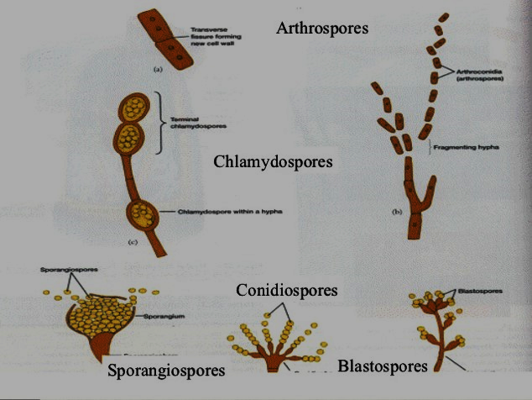
Reproduction of Fungi: Most fungi reproduce sexually and/or asexually

Slide 10
Ecology of Fungi: Fungi show very high diversity with respective high ecological adaptability. Fungi can grow in extreme environments with temperature range of -5 to 60 oC , low water activity of 0.65 or pH range of 1 to 9.
Taxonomy of Fungi:
Mixomycotina
Zygomycotina
Ascomycotina
Basidiomycotina
Duteromycotina (imperfect fungi ) does not contain sexual reproduction

