Slide 1
Particle wave properties
1

Slide 2
Course Outline...
Wave nature of particles: de-Broglie wave as matter waves, Waves of probability & wave function, Matter waves as group waves, phase velocity & group velocity, Particle diffraction & Davison-Germer experiment, Uncertainty principle and its applications
References:
A. Beiser, Concept of Modern Physics (or Perspective of Modern Physics), Tata-McGraw Hill, 2005
2

Slide 3
Light has a dual nature
Wave (electromagnetic) - Interference
- Diffraction
Particle (photons)
Photoelectric effect
Compton effect
Wave - Particle Duality for light

Slide 4
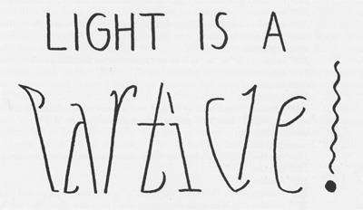
What about Matter?
If light, which was traditionally understood as a wave also turns out to have a particle nature, might matter, which is traditionally understood as particles, also have a wave nature?
Yes!

Slide 5
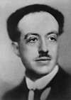
Louis de Broglie’s hypothesis
1905: Light behaves like a particle: p = h/ λ
1924: Matter behaves like a wave
λ = ^{h}
p
it turns out that everything's kind of mixed together at the fundamental microscopic level.
de Broglie’s wavelength
Both: Wave if λ >> scale Particle if λ << scale
Hypothesis in 1924, Nobel prize in 1929
55

Slide 6
the idea is: matter, because the momentum is so so so large compared to the photons, we'll have an extremely short wavelength.
Exp: What is the De Broglie wavelength of an electron that's moving at 2.2 x 10⁶ m/s ?
Now, this is really really really fast. 2.2 million meters per second. But it's not relativistic. It's still slow compared to the speed of light so we can still do everything fairly classically.
p = mv = 9.1 x 10⁻³¹x 2.2 x 10⁶ kg m/s = 2 x 10⁻²⁴ N.s
λ = h/p = 6.626 x 10⁻³⁴ / 2 x 10⁻²⁴ = 3.33 x 10⁻¹⁰ m
Now this is an important number: this speed: the kind of average speed of an electron in the ground state of hydrogen.
Let’s estimate for De Broglie wavelength
6

Slide 7
For a non-relativistic free particle:
Momentum is p = mv, here v is the speed of the particle For free particle total energy, E, is kinetic energy
h
2 2
₌ p ₌ mv
λ = ^{h} = ^{h} =
E = K
B
p mv
2Em
2m 2
Bullet: m = 0.1 kg; v = 1000 m/s
⇒ λ_{B} ~ 6.63×10⁻³⁶ m
Electron at 4.9 V potential:
m = 9.11×10⁻³¹ kg;
E~4.9 eV
⇒ λ_{B} ~ 5.5×10⁻¹⁰ m = 5.5 Å

Slide 8
Wave
Our traditional understanding of a wave….
Particle
Our traditional understanding of a particle…
“de-localized” – spread out in space and time.
*Disturbance in the medium
“Localized” - definite position, momentum, confined in space
9

Slide 9
How do we associate a wave nature to a particle
?
What could represent both wave and particle?
Find a description of a particle which is consistent with our notion of both
particles and waves……
Fits the “wave” description “Localized” in space

Slide 10
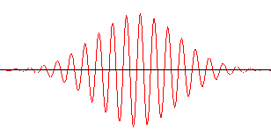
A “Wave Packet”
How do you construct a wave packet?

Slide 11
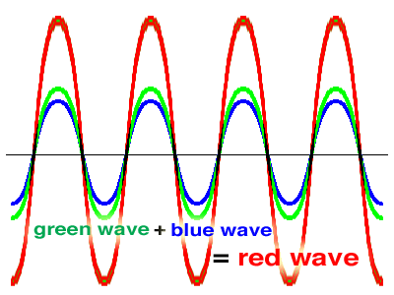
What happens when you add up waves?
The Superposition principle
Waves of same frequency

Slide 12
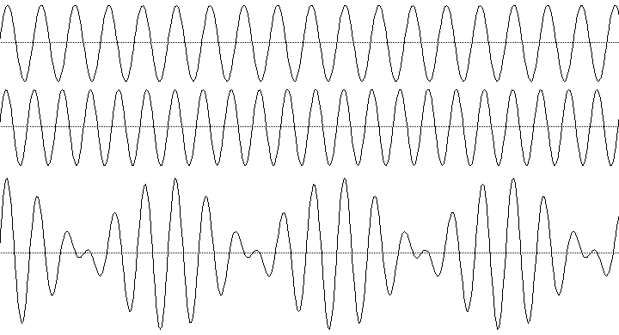
Adding up waves of different frequencies…..
Waves of slight different frequency

Slide 13
Constructing a wave packet by adding up
several waves …………
If several waves of different wavelengths (frequencies) and phases are superposed together, one would get a resultant which is a localized wave packet

Slide 14
A wave packet describes a particle
A wave packet is a group of waves with slightly different wavelengths interfering with one another in a way that the amplitude of the group (envelope) is non-zero only in the neighbourhood of the particle
A wave packet is localized – a good representation for a particle!
The spread of wave packet in wavelength depends on the required degree of localization in space – the central wavelength is given by
λ = ^{h}
p
What is the velocity of the wave packet ?

Slide 15
Wave packet, phase velocity and group velocity
The velocities of the individual waves which superpose to produce the wave packet representing the particle are different - the wave packet as a whole has a different velocity from the waves that comprise it
Phase velocity: The rate at which the phase of the wave propagates in space
Group velocity: The rate at which the envelope of the wave packet propagates

Slide 16
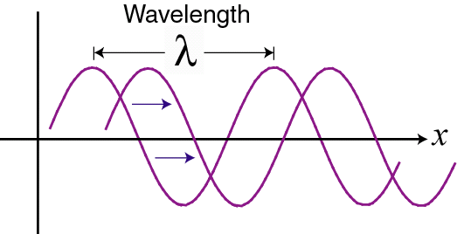
The Phase Velocity
How fast is the wave traveling?
Velocity is a reference distance divided by a reference time.
The phase velocity is the wavelength / period:
v = λ / τ
Since f = 1/τ :
v = f λ
In terms of k, k = 2π / λ, and
the angular frequency, ω = 2π / τ, this is:
v = ω / k

Slide 17
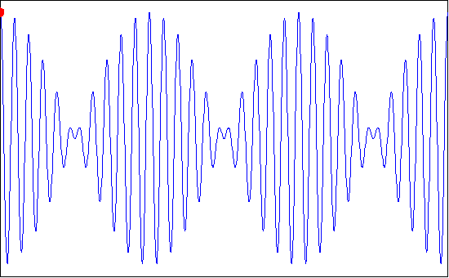
The Group Velocity
This is the velocity at which the overall shape of the wave’s amplitudes, or the wave ‘envelope’, propagates. (= signal velocity)
Here, phase velocity = group velocity (the medium is non- dispersive)
18

Slide 18
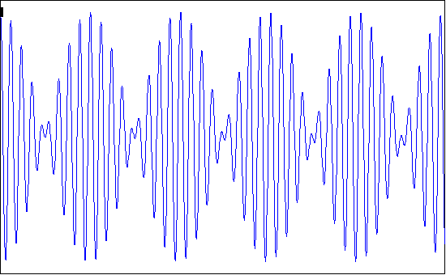
Dispersion: phase/group velocity depends on frequency
Black dot moves at phase velocity. Red dot moves at group velocity.
This is normal dispersion (refractive index decreases with increasing λ)
19

Slide 19
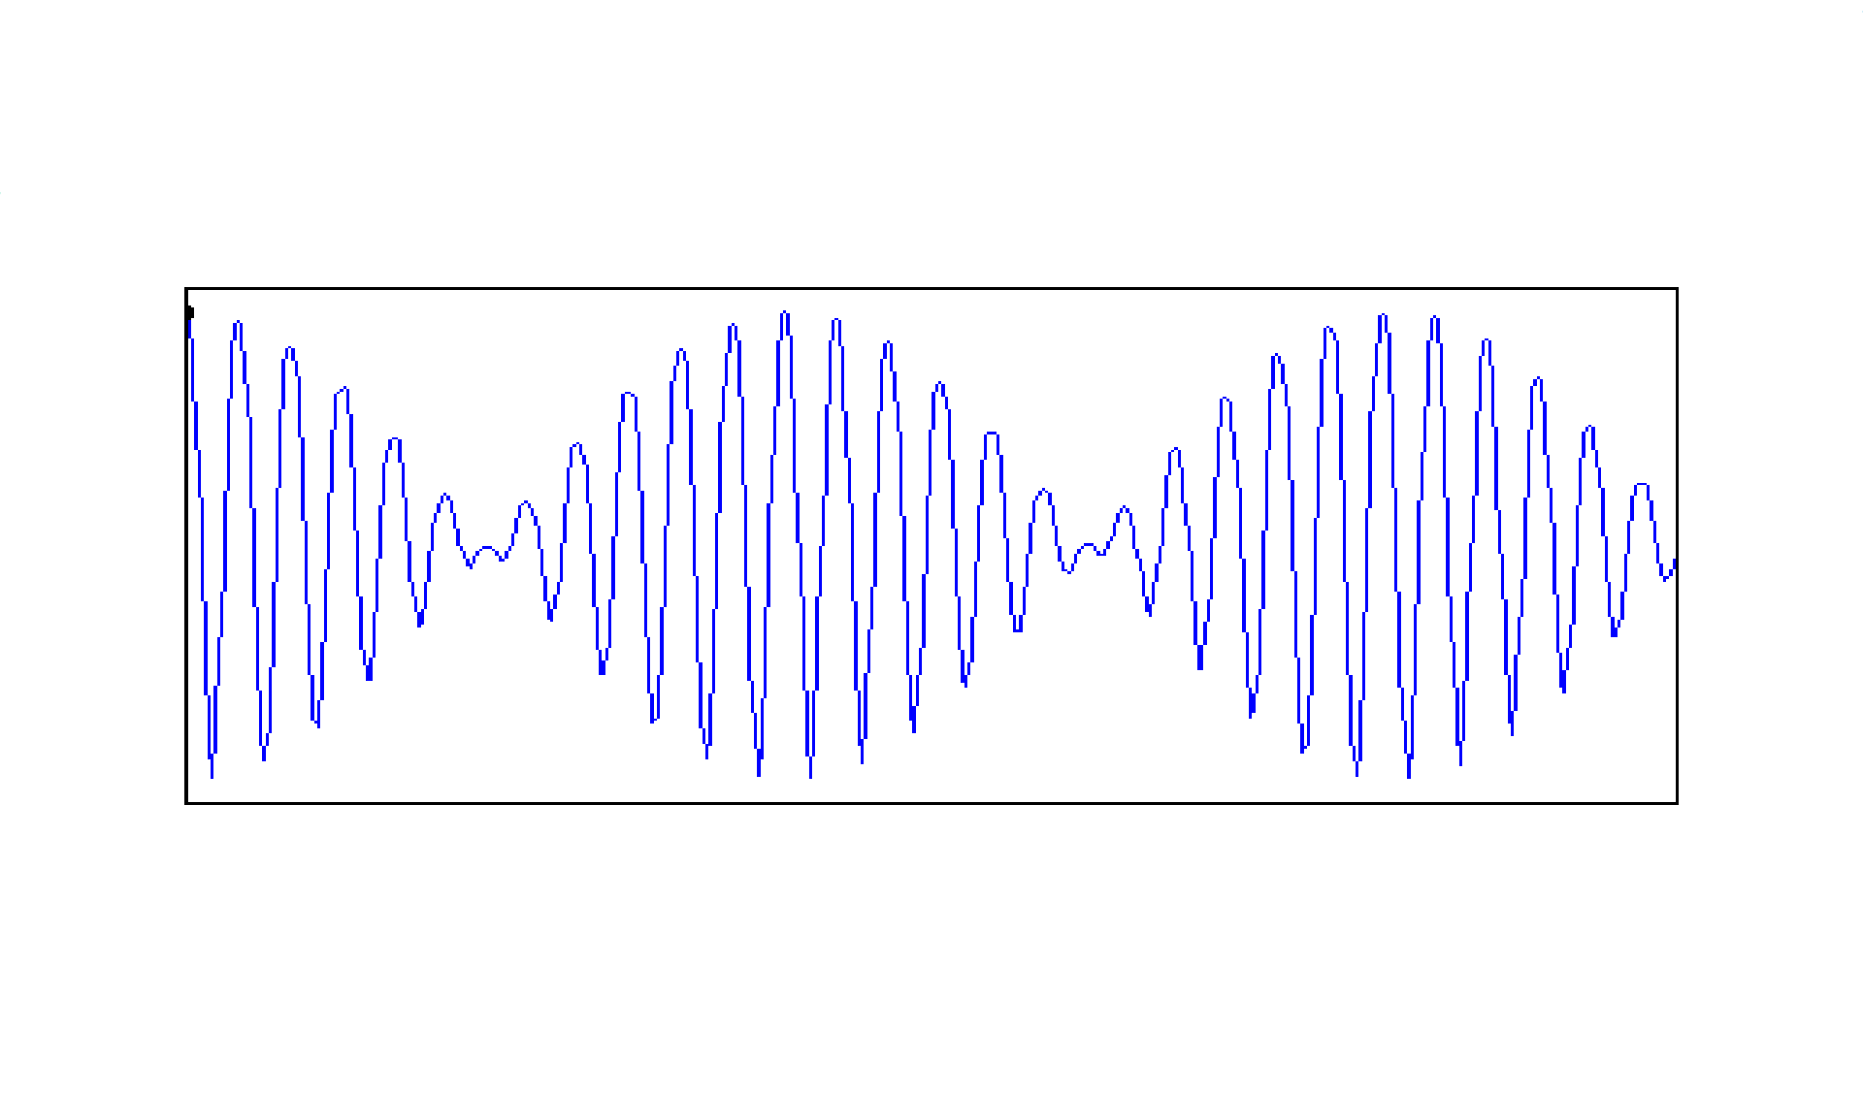
Dispersion: phase/group velocity depends on frequency
Black dot moves at group velocity. Red dot moves at phase velocity.
This is anomalous dispersion (refractive index increases with increasing λ)
20

Slide 20
What is a wave?
A wave is anything that moves!
Matter waves?
Quantities varies periodically:
Water waves: height of the water surface Sound waves: pressure
Light waves: E and M fields
The quantity whose variations make up matter waves is called
the wave function Ψ
Max Born (1926) extended this interpretation to the matter waves proposed by De Broglie, by assigning a mathematical function, Ψ(r,t), called the wavefunction to every “material” particle
Ψ(r,t) is what is “waving”
22

Slide 21
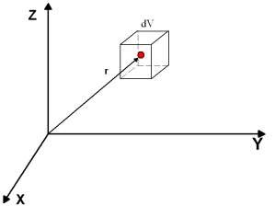
Definition of Ψ(r,t)
The probability P(r,t)dV to find a particle associated with the wavefunction Ψ(r,t) within a small volume dV around a point in space with coordinate r at some instant t is
P(r,t)dV = Ψ(r,t) ² dV
P(r,t) is the probability density
For one-dimensional case
P(x,t)dV = Ψ(x,t) ² dx
Here |Ψ(r,t)|² = Ψ*(r,t)Ψ(r,t)
A large value of |Ψ(r,t)|² means the strong possibility of the particle’s presence
23

Slide 22
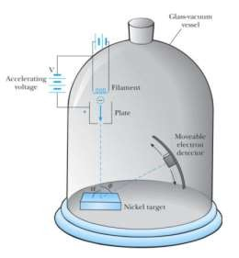
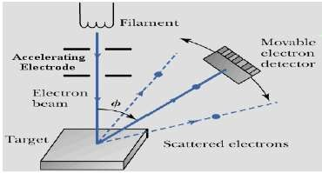
De Broglie’s Hypothesis:
predicts that one should see diffraction and interference of matter waves
Wave nature of electron big application : Electron Microscope
For example we should observe Electron diffraction
Atom or molecule diffraction
Davisson-Germer Experiment
provides experimental confirmation of the
matter waves proposed by de Broglie
If particles have a wave nature, then under appropriate conditions, they should exhibit diffraction
Davisson and Germer measured the wavelength
of electrons
Electrons were directed onto nickel crystals
Accelerating voltage is used to control electron
energy: E = |e|V
24

Slide 23
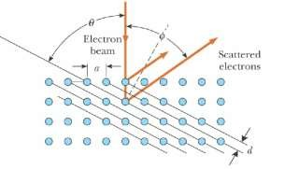
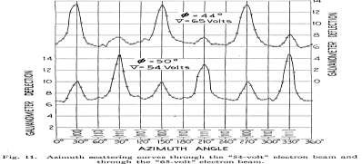
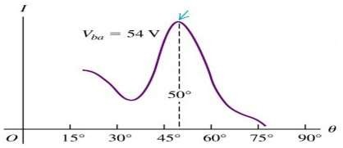
Continue…
If electrons are “just” particles, we expect a smooth monotonic dependence of scattered intensity on angle and voltage because only elastic collisions are involved
Diffraction pattern similar to X-rays would be observed if electrons behave as waves
Intensity was stronger for certain angles for specific accelerating voltages
(i.e. for specific electron energies)
Electrons were reflected in almost the same way that X-rays of comparable wavelength
Current vs accelerating voltage has a maximum, i.e. the highest number of
electrons is scattered in a specific direction
This can’t be explained by particle-like nature of electrons ⇒ electrons
scattered on crystals behave as waves
25

Slide 24
Single Electron Diffraction
Will one get the same result for a single electron?
Such experiment was performed in 1949.
Intensity of the electron beam was so low that only one
electron at a time “collided” with metal
Still diffraction pattern, and not diffuse scattering, was observed, confirming that
Thus individual electrons behave as waves
Electron Diffraction, Experiment
Parallel beams of mono-energetic electrons that are incident
on a double slit
The slit widths are small compared to the electron wavelength
An electron detector is positioned far from the slits at a distance much greater than the slit separation

Slide 25
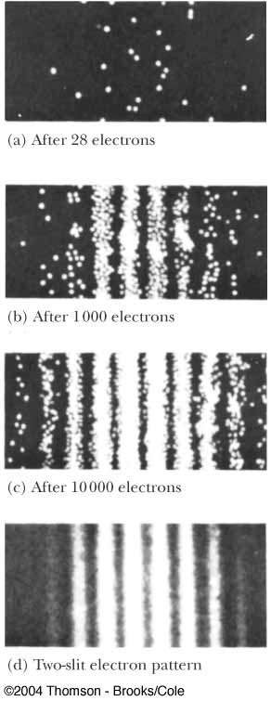
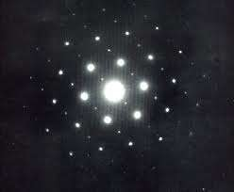
Observations:
If the detector collects electrons for a long enough time, a typical wave interference pattern is produced
:distinct evidence that electrons are interfering, a wave-like behavior
:The interference pattern becomes clearer as
the number of electrons reaching the screen increases
A maximum occurs when d sinθ = mλ
This is the same equation that was used for light
This shows the dual nature of the electron:
The electrons are detected as particles
at a
localized spot at some instant of time
The probability of arrival at that spot is determined by calculating the amplitude squared of the sum of all waves arriving at a point
Modern electron diffrac₂t₈ion

Slide 26
Electron Diffraction Explained:
An electron interacts simultaneously
with both slits
If an attempt is made to determine experimentally through which slit the electron goes, the act of measuring destroys the interference pattern
It is impossible to determine which slit the electron goes through
In effect, the electron goes through both slits. The wave components of the electron are present at both slits at the same time

Slide 27
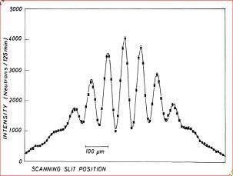
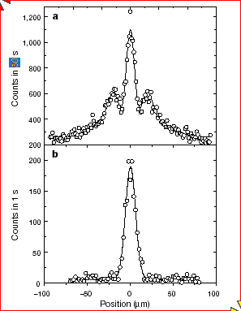
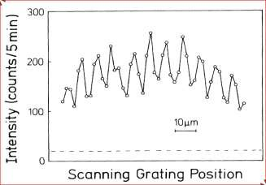
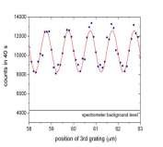
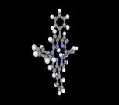
Other experiments showed wave nature for neutrons, and even big molecules, which are
much heavier than electrons!!
Neutrons
He atoms
C₆₀ molecules
A. Zeilinger et al, Vienna, 1999
Biomolecules have it too!
All material particles show diffraction ⇒ wave character

Slide 28
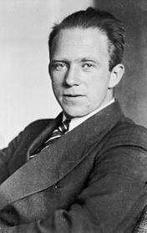
Uncertainty princip^{He}l^{i}e^{senberg}
1932 Nobel
“We can’t know the future because we can’t know the present”
Uncertainty Principle is an important consequence of the wave-particle duality of matter and radiation and is inherent to the quantum description of nature
Simply stated, it is impossible to know both the exact position and the exact momentum of an object simultaneously
A fact of Nature!
31

Slide 29
Heisenberg's Uncertainty Principle
Uncertainty in Uncertainty in
Position :
Δx
h
4π
Momentum:
Δp_{x}
ΔxΔp ≥
x
energy-time uncertainty relation
h
4π
ΔEΔt ≥
Consequences: The more accurately we know the energy of a body, the less accurately we know how long it possessed that energy
The energy can be known with perfect precision (ΔE = 0), only if the
measurement is made over an infinite period of time (Δt = ∞)
- applies to all “conjugate variables”

Slide 30
Consequences of the Uncertainty Principle
The path of a particle (trajectory) is not well- defined in quantum mechanics.
Electrons cannot exist inside a nucleus.
Atomic oscillators possess a certain amount of energy known as the zero-point energy, even at absolute zero.

Slide 31
Why isn’t the uncertainty principle apparent to us in our ordinary experience…?
Planck’s constant, again!!
h
2π
h = 6.6x10⁻³⁴ J.s
ΔxΔp ≥
x
Planck’s constant is so small that the uncertainties implied by the principle are also too small to be observed. They are only significant in the domain of microscopic systems

Slide 32
^{Appendix:}Energy-time uncertainty relation
h
4π
ΔEΔt ≥
Transitions between energy levels of atoms are not perfectly sharp in frequency.
n = 3
n = 2
An electron in n = 3 will spontaneously decay to a lower level after a lifetime of order ~ 10⁻⁸ s
E = hν₃₂
n = 1
Energy & time
Intensity
Δν₃₂
There is a corresponding ‘spread’ in the emitted
frequency
^{ν} 32
Frequency

Slide 33
Summary:
 Matter and radiation have a dual nature – of both wave and particle
 The matter wave associated with a particle has a de
Broglie wavelength given by
λ = ^{h}
p
 A (localized) particle can be represented by a group of waves called a wave packet
 The group velocity of the wave packet is
v_{g} = v
_{c} 2
v_{p} = _{v}
 The phase velocity of the wave packet is
36

Slide 34
 Group velosity and phase velocity can be related by
_{λ} dv_{p}
v = v
g
p
dλ
 Heisenberg’s
uncertainty principle is an
important consequence of the wave-particle duality of matter and radiation and is inherent to the quantum description of nature
 It applies to all conjugate variables and also to the notion of the wave packet
h
4π
h
4π
ΔxΔp ≥
ΔEΔt ≥
x

Slide 35
What next? – Matter wave interference for a Virus?!
If there is wave, there must be a wave
equation………
The Schrödinger Equation
NEXT CHAPTER

Slide 36
ASSIGNMENT-V
Due on 1/11/2013
1. Calculate the de-Broglie wavelength of
an electron having kinetic energy 3 GeV.
an oil drop of charge 2 x 10⁻⁸ C accelerated through a potential difference of 30 V
gλ
2π
2. The phase velocity of water waves of wavelength λ in deep water is v_{p} =
Find the group velocity.
Show that the group velocity v_{g} and phase velocity v_{p} of a relativistic particle satisfy the relation v_{p}v_{g} = c².
A particle of mass 50g moves at 100 m/s. Find the uncertainty in its momentum if its position is known to an accuracy of 1 mm. Find the ratio of this uncertainty to the momentum of the particle. Justify it.

