Slide 1
Tissue Optical Properties
Mohammed Alwan Kadhum

Slide 2
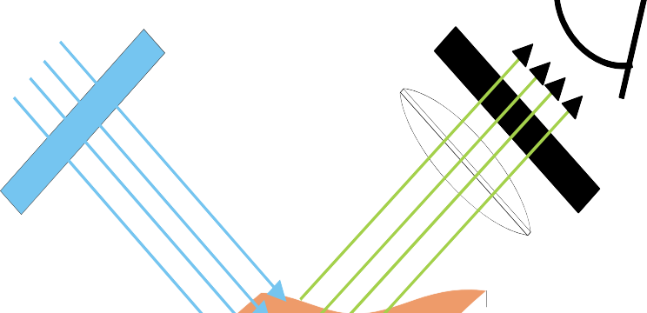
Introduction
Interaction between Light and Tissue
Reflection
Refraction
Absorption
Light Source
Optical Signal
Fluorescence
Scattering
Tissue
Depends on
Constituents of tissue
Optical properties of tissue
Propagation of light

Slide 3
Absorption
Extraction of energy from light by a molecular species
Diagnostic applications: Transitions between two energy levels of a molecule that are well defined at specific wavelengths could serve as spectral fingerprint of the molecule
Various types of Chromophores (light absorbers) in Tissue
Wavelength-dependent absorption
Tumor detection and other physiological assessments (e.g. pulse- oximetry)
Therapeutic applications: Absorption of energy is the primary mechanism that allows light form a source (laser) to produce physical effects on tissue for treatment purpose
Lasik (Laser Assisted in situ Keratomileusis) Eye Surgery, Tatoo Removal, PDT

Slide 4
Absorption
Absorption occurs when the photon frequency matches the frequency associated with the molecule s energy transition
Electrons absorb the energy of the light and transform it into vibrational motion
The absorption of a photon results in:
quantized change in charge separation
quantized excitation of vibrational modes
Electrons interact with neighboring atoms → convert vibrational energy into thermal energy
‘ ’ ’

Slide 5
Absorption
Each electronic energy
levels is associated with many vibrational energy levels
Vibrational Energy Level
Potential Energy
S₁
Absorption of UV and visible light promotes transition between electronic energy levels
Electronic Energy Level
S₀
Absorption of infrared light promotes transitions between vibrational energy levels

Slide 6
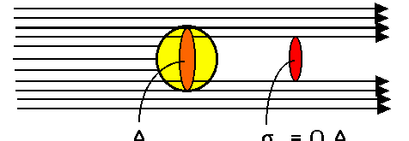
Absorption
Absorption Cross-section,
σ [m²]
Consider a chromophore idealized as a sphere with a particular geometrical size.
Consider that this sphere
blocks incident light and casts a shadow, which constitutes absorption.
The size of absorption shadow
= absorption cross-section
Qa: absorption efficiency
σ = Q ⋅ A
a
a

Slide 7
Absorption
P_{in} =I_{o}A
^{P}abs ^{= I}o^{σ}a
P_{out} = I_{o}(A-σ_{a})
Incident Beam
Outgoing Beam
Area =A
-
Area = σ_{a}
=
P_{out} = I_{o}(A-σ_{a}) area = A - σ_{a}
σ
₌ ^{P}abs
a
I
o

Slide 8
Absorption
Assumptions
Cross section is independent of relative orientation of the impinging light and absorber uniform distribution of N_{a} (molecules/cm³) identical absorbing particles
Absorption Coefficient, ma [1/m]
_{Ma} = N_{a} ⋅σ _{a}
Absorption cross-sectional area per unit volume of medium
Absorption mean free path, la [m]
l = ¹
a
μ
a
Represents the average distance a photon travels before being absorbed

Slide 9
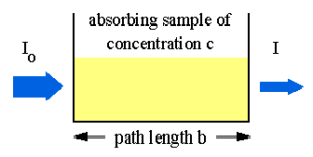
Absorption
Transmission and Absorbance (macroscopic view)
Transmission
T = ^{I}
I_{o}
Absorbance (attenuation, or optical density)
A = −log(T ) = log ^{⎛ Io ⎞}
⎜ _{I} ⎟
⎝ ⎠

Slide 10
Absorption
Lambert – Beer Law:
The linear relationship between absorbance and concentration of an absorbing species.
Relates μ_{α}, transmission, and absorbance
_{I = I e}− μ_{a} ⋅b o
μ_{a} = N_{a} ⋅σ _{a}
σ
₌ ^{P}abs
a
I
σ= absorption cross-sectional area [cm²]
I_{O} = The intensity entering the sample at z = 0 [w/cm²]
O
I = The intensity of light leaving the sample [w/cm²] b = pathlength traveled in the sample [cm]

Slide 11
Absorption
Absorbers in Tissue
NIR
VISIBLE
UV
NIR
UV-VIS
Hemoglobin
Lipids
Water
DNA
Hemoglobin
Lipids
Structural protein
*
Electron carriers*
Amino acids*
* Absorbers that fluoresce when excited in the UV-VIS

Slide 12
Absorption
UV Absorption
Protein, amino acid, fatty acid and DNA absorption dominate UV absorption
Protein
Dominant ‘non-water’ constituent of all soft tissue, ~ 30%
Absorption properties
Amino Acid
determined by peptide bonds and amino acid residues
Peptide excitation about λ =
190 nm
Amino acids absorption at λ = 210 - 220 nm and 260 – 280 nm
Peptide
DNA
Absorbs radiation for λ ≤ 320 nm
Large water absorption λ< 180 nm

Slide 13
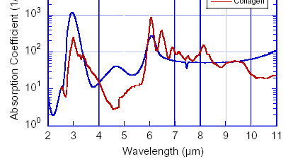
Absorption
Infrared Absorption
Protein IR absorption peaks at 6.1, 6.45, and 8.3 μm due to amide excitation
Absorption depth ≤ 10 μm in λ
= 6-7 μm region
Water absorption peak at 0.96, 1.44, 1.95, 2.94 and
μm
Absorption depth
~ 500 mm at λ = 800 nm
<1 μm at λ=2.94 μm
≤ 20 μm throughout λ ≥ 6 μm

Slide 14
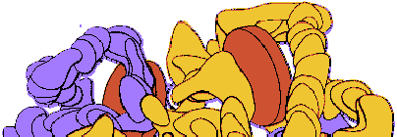
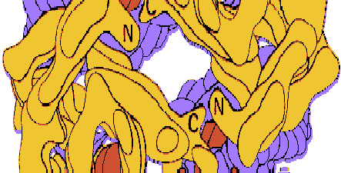
Absorption
Main Absorbers at visible and NIR
10⁶
Extinction Coeff (1/cm M)
Hemoglobin
Lipid
Hemoglobin
10⁵
10⁴
Hb
10³
HbO
2
400 500 600 700 800 900 1000
10²
Each hemoglobin has 4 heme (Fe²⁺) sites to bind O₂
WAVELENGTH (NM)
Responsible for oxygen transport
•HbO₂ and Hb
oxygen saturation is an indicator of oxygen delivery and utilization as well as metabolic activity

Slide 15
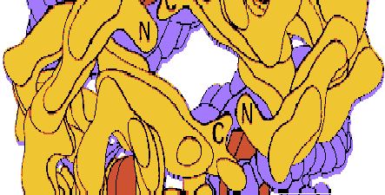
Absorption
Hemoglobin
Responsible for oxygen transport
HbO2 and Hb
oxygen saturation is an indicator of oxygen delivery and utilization as well
10⁶
Extinction Coeff (1/cm M)
10⁵
as metabolic activity
Deoxyhemoglobin has lower
absorption than oxyhemoglobin in the blue and green
Bright red arterial blood
Bluish venous blood
Absorption peaks for HbO₂
418, 542, 577, and 925 nm
Absorption peaks for Hb
10⁴
Hb
10³
HbO
2
400 500 600 700 800 900 1000
10²
WAVELENGTH (NM)
550, 758, 910 nm
Isosbestic points
547, 569, 586, and 798 nm

Slide 16
Absorption
Lipid (Fat)
Important energy store in the body
3.0
0.06
HEMOGLOBIN (1/mm mM)
2.5
Water
0.05
Site-specific measurements of body composition
Monitoring of physiological
WATER & FAT (1/ mm mM)
2.0
0.04
HB
0.03
1.5
changes in female breast tissue
Tissue layer model
1.0
0.02
Lipid
0.01
0.5
HbO
2
0.00
0.0
600
700 800
900
1000
WAVELENGTH (nm)

Slide 17
Scattering
Change of direction of propagation and/or energy of
light by a molecular species
Diagnostic applications: Scattering depends on the size, morphology, and structure of the components in tissues (e.g. lipid membrane, collagen fibers, nuclei).
Variations in these components due to disease would affect scattering properties, thus providing a means for
diagnostic purpose
Therapeutic applications: Scattering signals can be
used to determine optimal light dosimetry and provide useful feedback during therapy

Slide 18
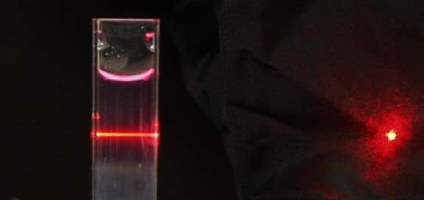
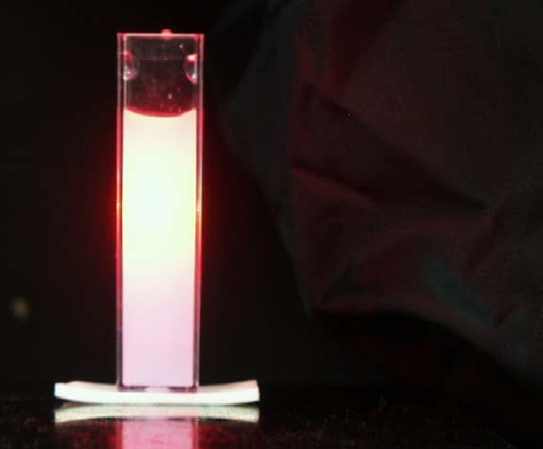
Scattering
Purely absorbing
With Scattering
Photon pathlength = L
Photon pathlength >> L
L
Lambert- Beer Law does not apply here!!! Need to calculate true pathlength of light

Slide 19
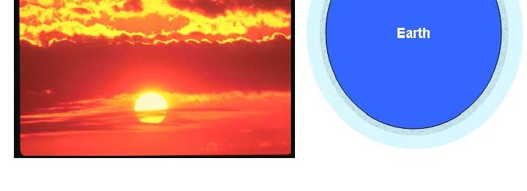
Scattering
Why is the sky blue, clouds white, and sunsets red?
Blue skies are produced due to scattering at shorter wavelengths
Visible light (violet & blue) are selectively scattered by O2 and N2 – much smaller than wavelengths of the light
violet and blue light has been scattered over and over again
When light encounters larger particles (cloud, fog), Mie scattering occurs
Mie scattering is not wavelength dependent – appears white
Cigarette smoke, too
At sunset
The light must travel over a longer path in the atmosphere
Blue/green is scattered away and only red/orange (scattered less) reaches your eyes

Slide 20
Scattering
Mechanism for Light Scattering
Light scattering arises from the presence of heterogeneities within a bulk medium
Physical inclusions
Fluctuations in dielectric constant from random thermal motion
Heterogeneity/fluctuations → non-uniform temporal/spatial distribution of refractive index in the medium
Passage of an incident EM wave sets electric charges into oscillatory motion and can excite vibrational modes
Scattered light is re-radiated by acceleration of these charges and/or relaxation of vibrational transition

Slide 21
Scattering
Elastic scattering: no energy change
Frequency of the scattered wave = frequency of incident wave
Probes static structure of material
Rayleigh and Mie scattering
Inelastic scattering: energy change
Frequency of the scattered wave ≠ frequency of incident wave
Internal energy levels of atoms and molecules are excited
Probes vibrational bonds of the molecule
Raman scattering (stokes↓ and anti-stokes ↑)

Slide 22
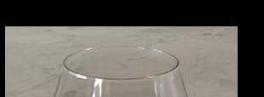
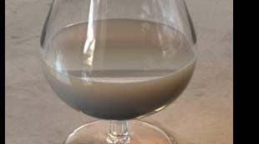
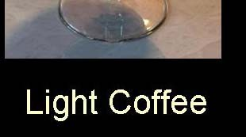
Scattering
Elastic Scattering
The light scattered by a system
has interacted with the inhomogeneities of the system
Photons are mostly scattered
by the structure whose size matches the wavelength
Principal parameters that affect scattering
Wavelength, λ
Relative refractive index
Particle radius
Shape and orientation
Two types of scattering: Rayleigh and Mie

Slide 23
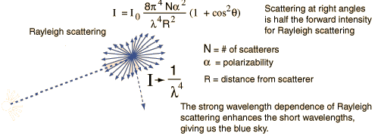
Scattering
Rayleigh Scattering
Light Source
Detector
Scattering from very small particles → ≤ λ/10
Rayleigh scattering is inversely related to fourth power of the wavelength of the incident light
I ∝ ¹
λ is the wavelength of the incident light I is the intensity of the scattered light
_{λ}4

Slide 24
Scattering
Mie Scattering
For scattering of particles comparable or larger than the wavelength, Mie scattering predominates
Because of the relative particle size, Mie scattering is not strongly wavelength dependent
Forward directional scattering

Slide 25
Scattering
P_{in} =I_{o}A
^{P}scatt ^{= I}o^{σ}s
P_{out} = I_{o}(A-σ_{s})
Incident Beam
Outgoing Beam
Scattering Cross Section, σ_{scatt} [m²]
‘area’ of an index-matched, perfectly absorbing disc necessary to produce
The measured reduction of light
^{σ}scatt ^{= Q}s^{*A}s
Q_{s}: Scattering efficiency (calculated by Mie theory); defined as the ratio of the scattering section to the projected area of the particle on the detector
A_{s}: Area of Scatterer [m2]

Slide 26
Scattering
Scattering Coefficient, μ_{s} [1/m]
μ_{s} =N_{s}σ_{s} ,
N_{s} = the number density of scatterers
σ_{s} = scattering efficiency
Cross-sectional area for scattering per unit volume of medium
Scattering Mean Free Path, l_{s}
Average distance a photon travels between scattering events
l = ¹
s
μ
s

Slide 27
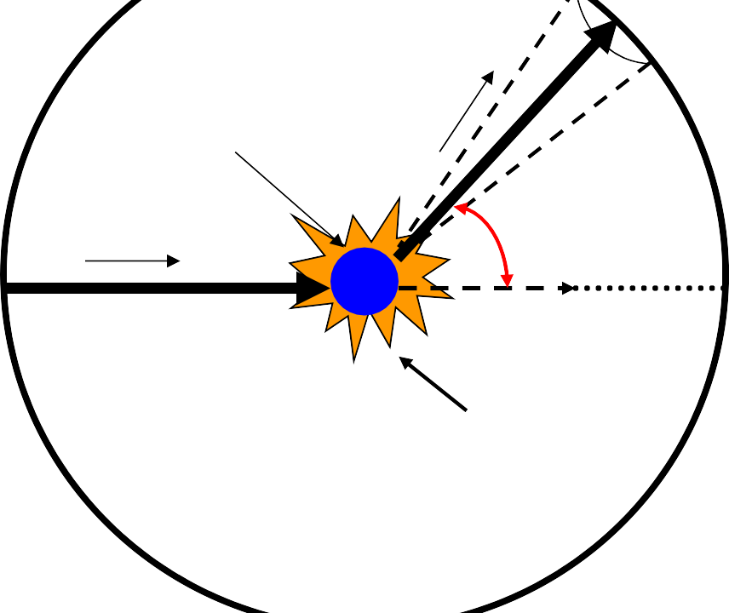
Scattering
Anisotropy, g
Imagine that a photon is scattered by a particle so that its trajectory is deflected by an angle, θ
dΩ
scattered _{S’}
photon
hv
Scatterer
Then, component of a new trajectory aligned forward direction is cos(θ)
Anisotropy is a measure of forward direction retained after a single scattering event, < cos(θ)>
hv
Photon trajectory
Scattering Angle (θ)
cos (θ)
Incidenet Photon
S
Scattering event
⎧− 1totally backward scattering
g = ⎪ 0
⎨
isotropic scattering
totally forward scattering
Biological Tissues: 0.65 < g <0.95
⎪ ₁
⎩

Slide 28
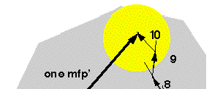
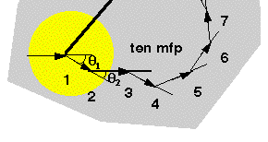
Scattering
Reduced Scattering Coefficient, μs’ [1/m]
μs’ incorporates the
scattering coefficient, μs
and the anisotropy factor, g
μ_{s} ' = (1 − g)μ_{s}
μs’ can be regarded as an
effective isotropic scattering coefficient that represent the cumulative
≈ 26º
effect of several forward- scattering events
Special significant with
g = cosθ = 0.90
μ_{s} ' = (1− g)μ_{s} = 0.10μ_{s}
respect to photon diffusion theory
mpf = 1/ μ_{s}
mpf ' = 1/ _{s} ' = 10mpf = 10 / μ_{s}

Slide 29
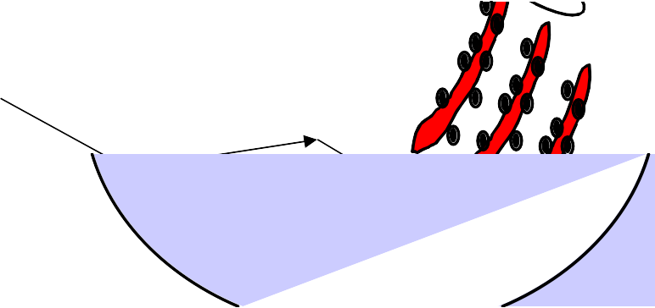
Scattering
Scattering in Tissue
Tissue is composed of a ‘mixture’ of Rayleigh and Mie scattering
10 μm
cells
nuclei
mitochondria
1 μm
Mie Scattering
lysosomes, vesicles
0.1 μm
striations in collagen fibrils macromolecular aggreagates
Rayleigh Scattering
0.01 μm
membranes

Slide 30
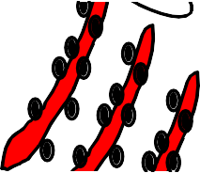
Scattering
Scattering in Tissue
Refractive index mismatch
between lipid and
surrounding aqueous medium
Soft tissues are dominated by lipid contents
Celluar membranes, membrane
folds, and membraneous structure
Mitochondria, ~ 1μm
Intracelluar organelle
composed of many folded membrane, cristae
Collegan fibers, 2 ~ 3μm
Collegan fibrils, 0.3 μm
Periodic fluctuation in collegan
ultrastructure →source of
Rayleigh scattering in UV and Visible range
Cells

Slide 31
Light Transport in Tissue
Modeling of light transport in tissues are often governed by the relative magnitudes of optical absorption and scattering
μa >> μs’ : Lambert-Beer Law (λ ≤300nm;λ≥2000nm)
μs’ >> μa : Diffusion Approximation (600nm ~ 1000nm)
μs’ ~ μa : Equation of Radiative Transfer, Monte Carlo (300nm
~ 600 nm; 1000nm ~ 2000nm)
Physical Pathlength: L_{p}
Optical Pathlength: L_{o}
Use Monte Carlo, Transport Theory, or Diffusion Theory
Biological Tissue Lo/L_{p} = 4 or ↑

Slide 32
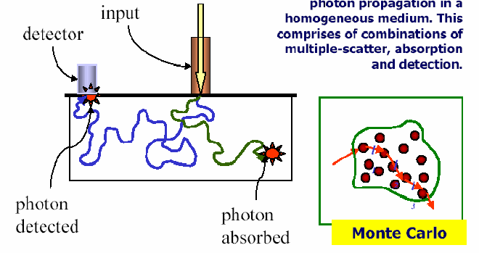
Light Transport in Tissue
Modeling Photon Propagation
μ_{a}, μ_{s}, g, phase function S “Stochastic” Description

